Slide 1
Measurement and Analysis of VDI System in the Wild
Chunghan Lee, Tatsuo Kumano, Tatsuma Matsuki,
Hiroshi Endo, Naoto Fukumoto, Mariko Sugawara
the 10th ACM International Systems and Storage Conference (SYSTOR’17)
Nov.09.2018
Fujitsu Laboratories Ltd.

Slide 2
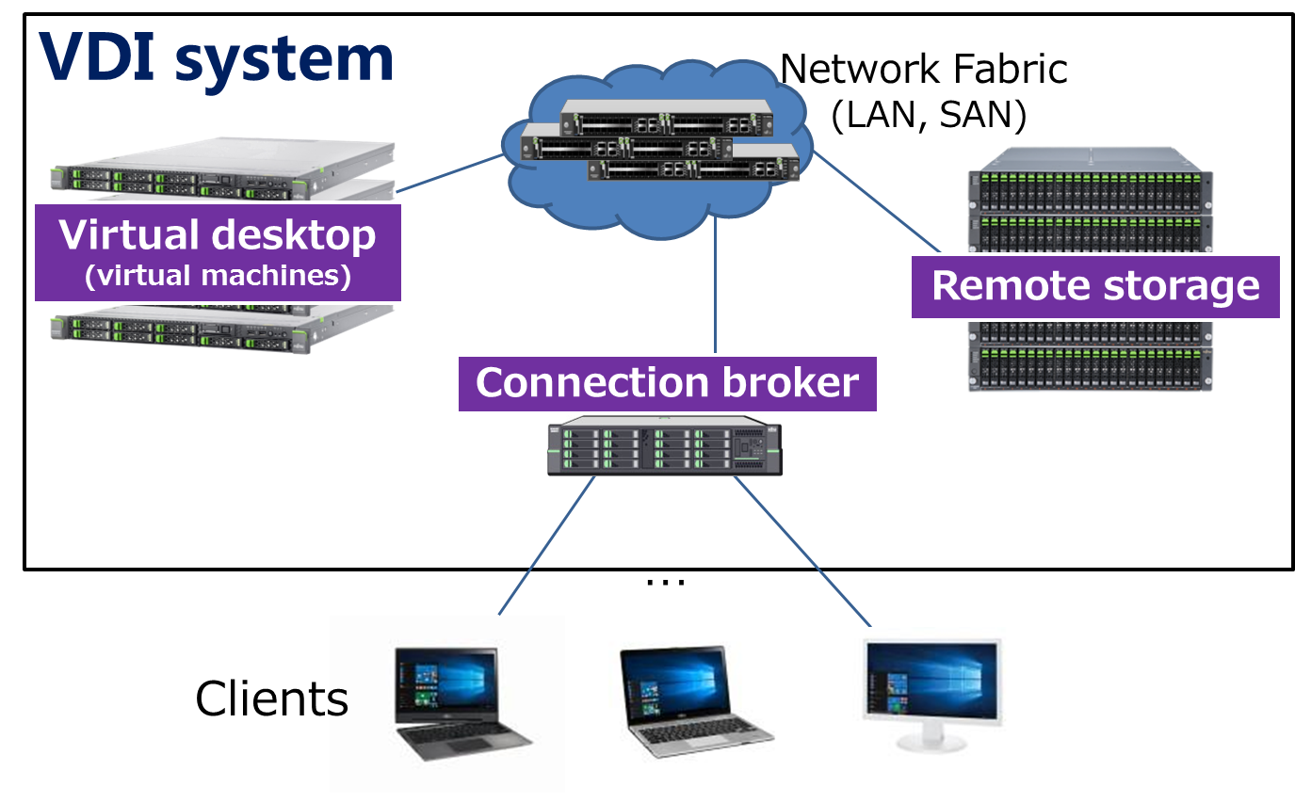
Introduction
Virtual desktop infrastructure (VDI)
  It can enhance security and reduce management costs
  It has been used in real-world offices and universities

Slide 3
Previous works on VDI systems
Previous studies have analyzed the common Internet file system (CIFS) and storage traffic in personal cloud storage
Few prior works on VDI system
  Only one field study [FAST’11] with a small-scale VDI (55 VMs)
  They analyzed storage traffic characteristics on the small-scale VDI by collecting traces from a specific component

Slide 4
Research goal
A deep understanding of storage traffic characteristics: FC traffic and VM behavior
with large-scale VDI

Slide 5
Approach
Focus on two perspectives:
fibre channel (FC) traffic and VM behavior
  Gather actual data from a part of an enterprise VDI for
  28 consecutive days
  Datasets consist of various types of traces, including a usage questionnaire and active and passive measurements
  Analyze datasets corresponding to 79.8 TiB of storage traffic on approximately 300 VMs

Slide 6
Key findings
We mainly present key findings (3,4 and 6)
FC traffic | 1. Read traffic is dominant
 | 2. During an update storm, a large number of transactions access similar address blocks in bursts
 | 3. During the storm, the write response times of large size transactions are degraded
VM behavior | 4. Although few VMs generate dominant traffic, their impact is small
 | 5. Anti-virus and Windows service in idle VMs generate large traffic
 | 6. All active VMs generate only 25% of traffic
Refer to our detailed contributions in ACM SYSTOR’17 paper ☺

Slide 7
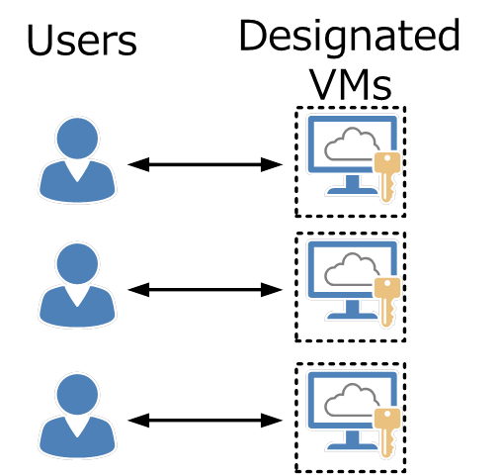
Target VDI
Overview of target VDI
  It is a part of a office VDI system
    Six servers (300 VMs) and six block storage with FCoE fabric
  It provides a designated Windows VM to each user
  It also provides pre-installed applications, such as a mailer (Outlook), Microsoft Office, and anti-virus software (McAfee)
  Users can install desired applications and save their data anytime

Slide 8
How to measure target VDI?
1. We cannot install monitoring components
on a VM or hypervisor
→ We captured FC traffic, and gathered performance metrics
from the storage and VDI servers
2. The VMs are always running to reduce the impact
of time-consuming operations, such as VM restart
→ We gathered connection broker logs from VDI portal
to distinguish active VMs (connected to users)
3. We cannot log on to user VMs, and it is hard to
inspect user applications on the VM
→ We gathered a list of applications at all VMs, and distributed
a usage questionnaire to determine which applications were
actually run

Slide 9
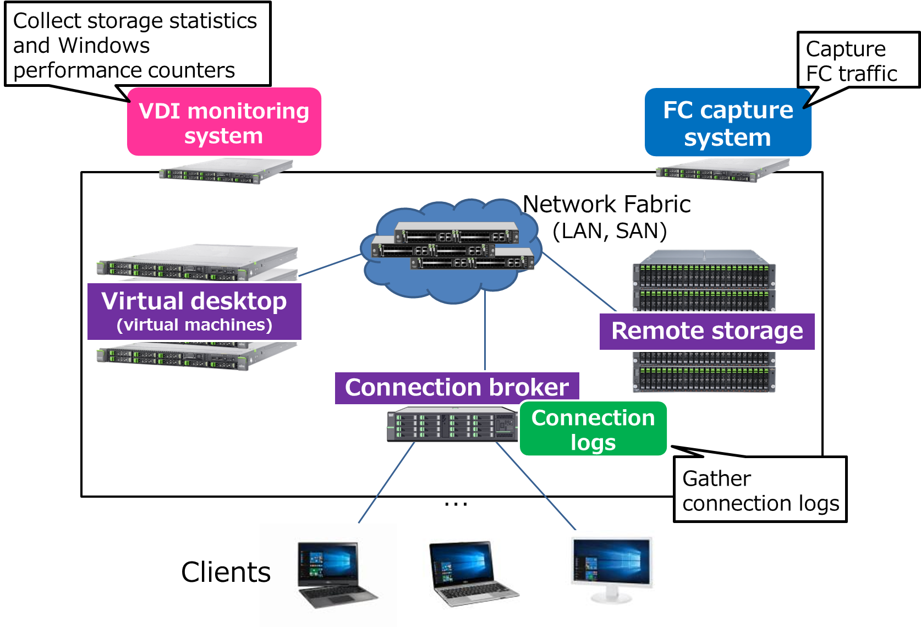
Measurement methodology
Gather various datasets for 28 consecutive days

Slide 10
Datasets for analysis
Usage questionnaire
FC traces
(28 consecutive days)
The black color indicates offline data
Datasets
Daily list of applications
from all VMs
Connection broker logs
(28 consecutive days)
Windows performance
counters using WMI*
(28 consecutive days)
Storage performance
statistics
(28 consecutive days)
*Windows Management Instrumentation (WMI)

Slide 11
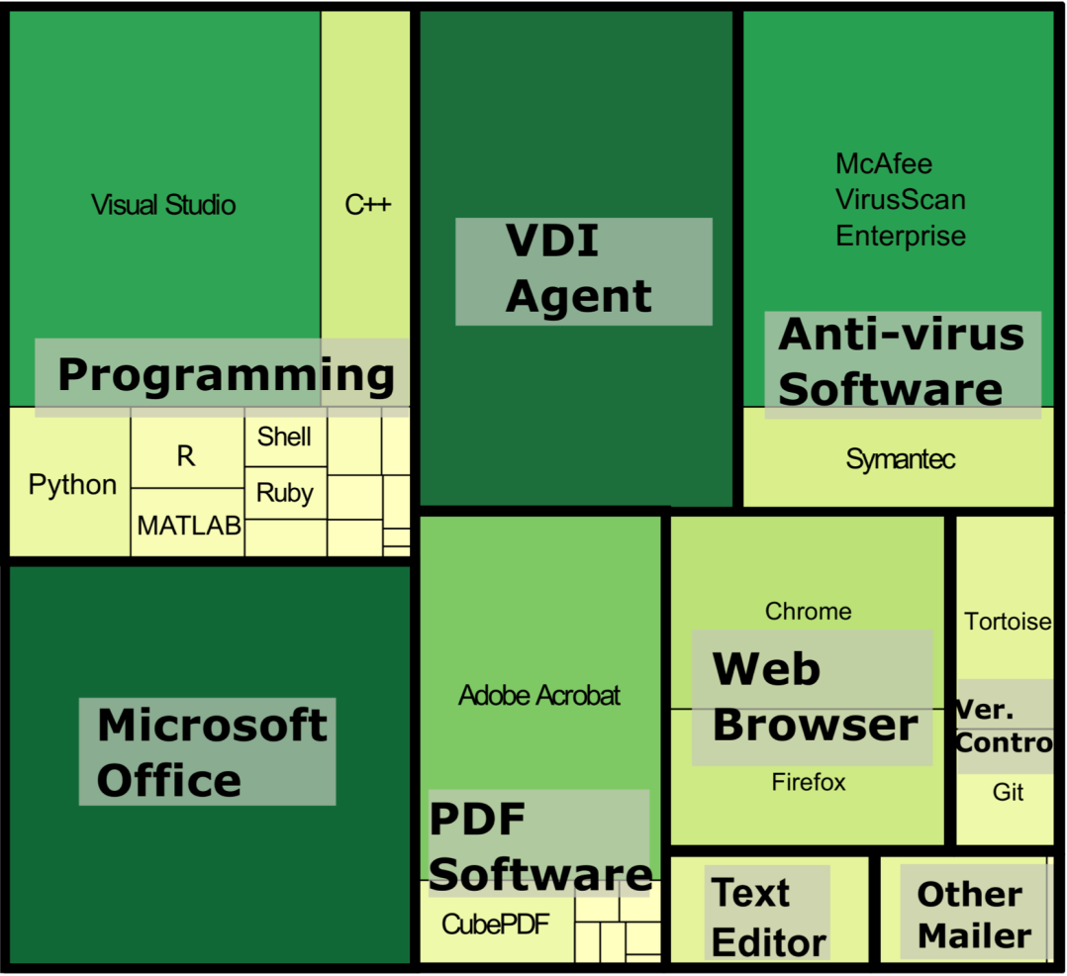
Applications installed on the VMs
TreeMap
  We manually and empirically classified the applications into nine categories
  The pre-installed software, such as Microsoft Office and anti-virus, had the large proportion
  We also found the similar characteristics with the usage
  questionnaire results
  The applications were similar to those of the small-scale VDI [FAST’11]
Deeper colors and larger rectangles indicate larger proportions

Slide 12
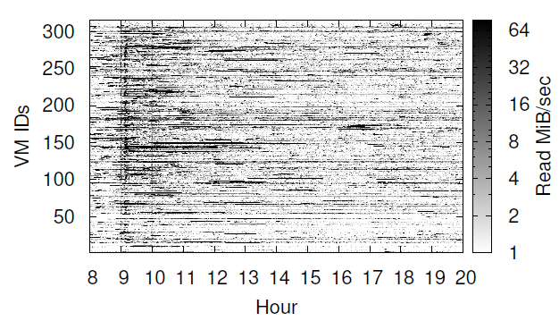
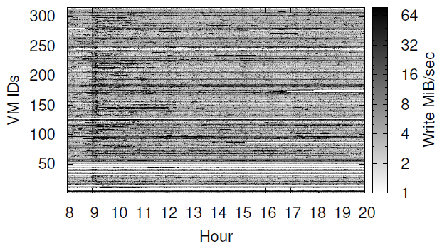
VM-level traffic
Read and write traffic
  Burst read traffic (deep black color) occurs, while continuous small write traffic (light gray color) is observed
    Read traffic is dominant (82%)
  Massive traffic is intensively generated in the morning (09:00)
  The VM-level traffic widely fluctuates and depends both on time and the VMs
    It would be possible to exist heavy VMs that generated dominant traffic
<Read>
<Write>

Slide 13
Questions from the results
1. What happened in the morning (09:00-10:00)?
2. Why read traffic is dominant?
3. How the heavy VMs are affected to the VDI system?

Slide 14
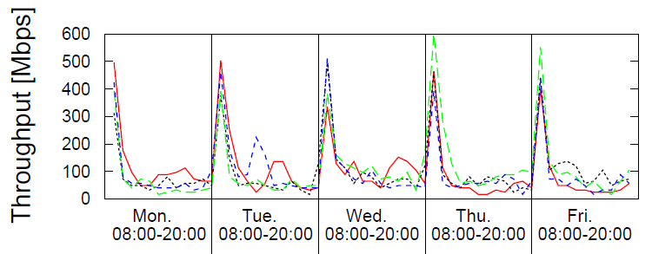


What happened in the morning?
Daily distribution of write throughput
  From application logs, we found the regular update of anti-virus
  The update was simultaneously executed by hundreds of VMs, and it acts as an update storm
  During the update storm, the large throughput of both read and write traffic was achieved, and their response time was also largely increased
<Write throughput>
1st week
2nd week
3rd week
4th week

Slide 15
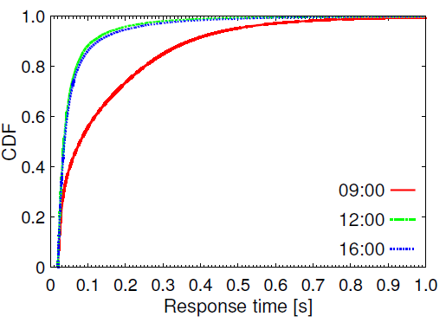
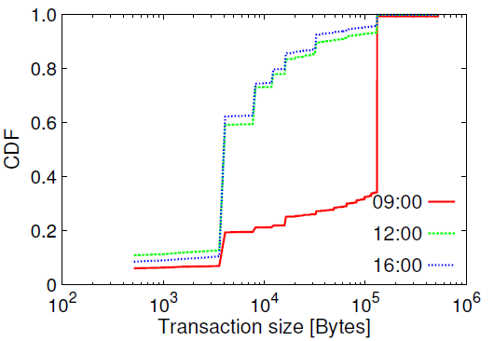
Characteristics of update storm – (1)
The storage response time was largely degraded from 20 ms during the update storm
  20 ms : the recommend response time by VMWare
Write response time
  In the morning, the CDF shape differs from the other time bins
Write size distribution
  In the morning, the large size (128 KiB) has large proportion
<Response time over 20ms>
<Size distribution over 20ms>
128 KiB
Slow
(in the morning)
** VMware. Storage I/O control technical overview and considerations for deployment http://www.vmware.com/files/pdf/techpaper/VMW-vSphere41-SIOC.pdf.

Slide 16
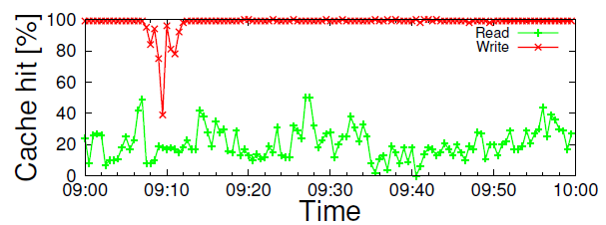
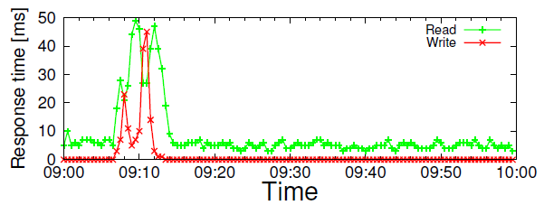
Characteristics of update storm – (2)
Write response time is affected by write transaction size
  The write response time of large size transaction is greatly affected even when write cache hit rate is slightly decreased
  Under a lack of write cache memory, the large write transactions are much more affected than the small ones
<Write size distribution over 20ms>
Update storm
128 KiB
Update storm

Slide 17
Characteristics of update storm – (3)
Implication from the analysis results
The transaction size for write cache hit rate should be considered to improve
overall VDI performance
<Write size distribution over 20ms>
Update storm
128 KiB
Update storm

Slide 18
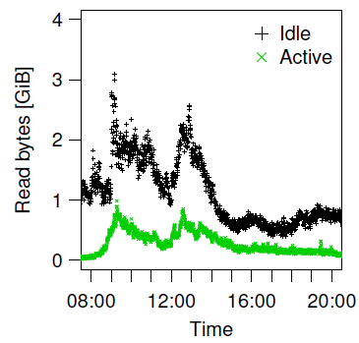
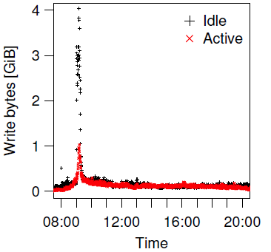
Major cause of dominant read traffic – (1)
  The idle VMs generate large read traffic
  The idle VMs (not connected to users) account for 75.5% of total traffic
    Anti-virus and Windows service were major applications to generate large read traffic
  The active VMs (connected to users) issue 24.5% of total traffic
<Read>
<Write>
Update storm
Update storm

Slide 19
Major cause of dominant read traffic – (2)
Implication from the analysis results
Traffic from active VMs should be more highly prioritized to shorten their response time
<Read>
<Write>
Update storm
Update storm

Slide 20
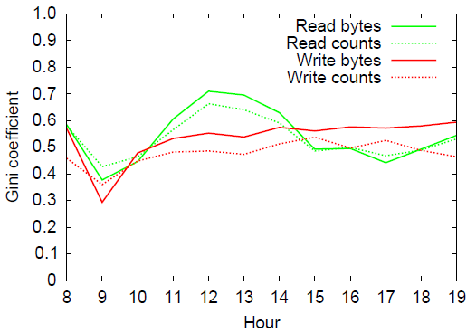
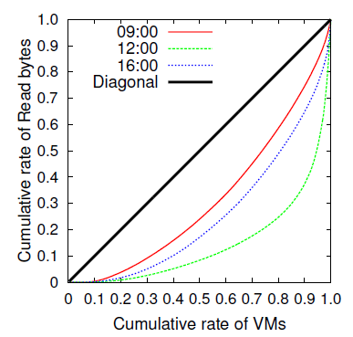
Traffic distribution across VMs – (1)
The morning (09:00-10:00)
  The traffic distribution at all VMs is almost homogeneous traffic
  The update storm is a major cause
The lunch time (12:00-13:00)
  The traffic distribution at all VMs is heterogeneous traffic
  The scheduled virus scan by some VMs is a major cause
  1% of active VMs only generate 16.6% of traffic
<Lorenz curve of read bytes>
<Gini coefficient>
Heterogeneous
traffic
Scheduled virus scan
Homogeneous
Update storm
Heterogeneous
Homogeneous traffic

Slide 21
Traffic distribution across VMs – (2)
Implication from the analysis results
The impact of heavy VMs is small and
especial load balancing strategy is not needed
to office VDI system
<Lorenz curve of read bytes>
<Gini coefficient>
Heterogeneous
traffic
Scheduled virus scan
Homogeneous
Update storm
Heterogeneous
Homogeneous traffic

Slide 22
Conclusion
1. What happened in the morning (09:00-10:00)?
→ The update storm of anti-virus software
The transaction size for write cache hit rate should be considered to improve overall VDI performance
2. Why read traffic is dominant?
→ The heavy read traffic from idle VMs
Traffic from active VMs should be more highly prioritized to shorten their response time
3. How the heavy VMs are affected to the VDI system?
→ The impact of heavy VMs is small and
1% of active VMs generate only 16.6% of traffic
The VDI system can perform sufficiently by using
uniform load balancing strategy

Slide 23
Future work
Analyze the characteristics of user application workloads on the active VMs
Investigate the storage traffic characteristics on different types of VDI system
*Public open datasets (SNIA repository)
http://iotta.snia.org/tracetypes/3

Slide 25
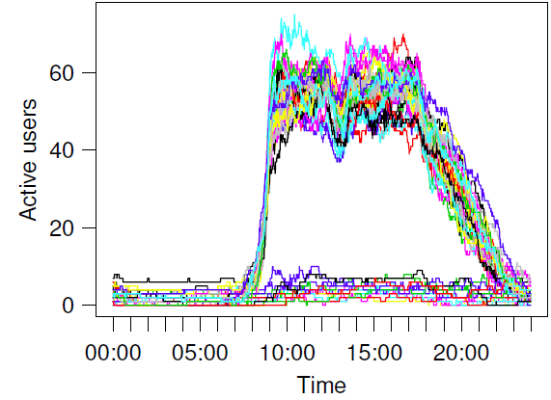
Daily active users
Patterns of daily active users
  Two patterns are observed: weekday and weekend
  We determine the measurement period (08:00-20:00) based on daily active users
<Daily active users>
Measurement period
Weekday
Weekend

Slide 26
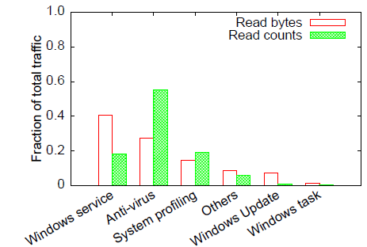
Major applications on idle VMs
Windows service, anti-virus, and system-profiling are major applications to generate large read traffic
The read traffic at idle VM is 93%

Slide 27
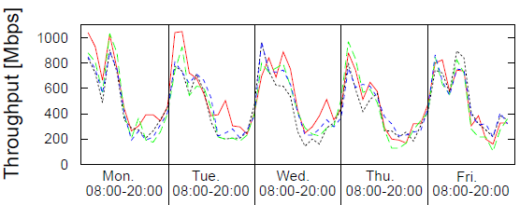
Daily read throughput
Obvious periodicity pattern with three time bins
  Morning : 09:00-10:00
  Lunch time : 12:00-13:00
  Afternoon : 16:00-17:00
Morning
(update storm)
Lunch time
(scheduled virus scan)
Afternoon
1st week
2nd week
3rd week
4th week

Slide 28
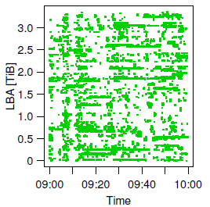
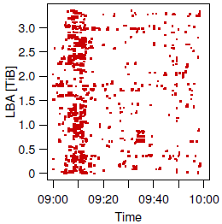
Spatial distribution at LUN
During the update storm, a large number of transactions access similar address blocks in bursts over a short period of time
Update storm
Update storm
<Read>
<Write>

Slide 29

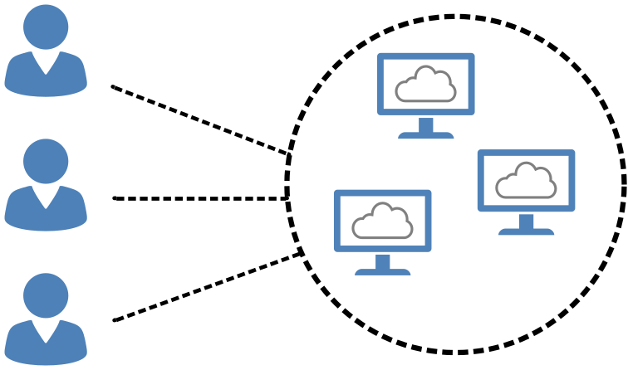
Target VDI
Using designated VM
  A designated VM is provided to each user
  Users log on their VM only, install desired applications and save their data anytime
Pool-based VDI
  A new VM is always provided to each user
  Users cannot install desired applications because they have no permission to control their VMs
  If a connection is broken to a VM, all of status are deleted
Our target VDI
Users
Designated VMs
Users
VM pool

